Slide 1
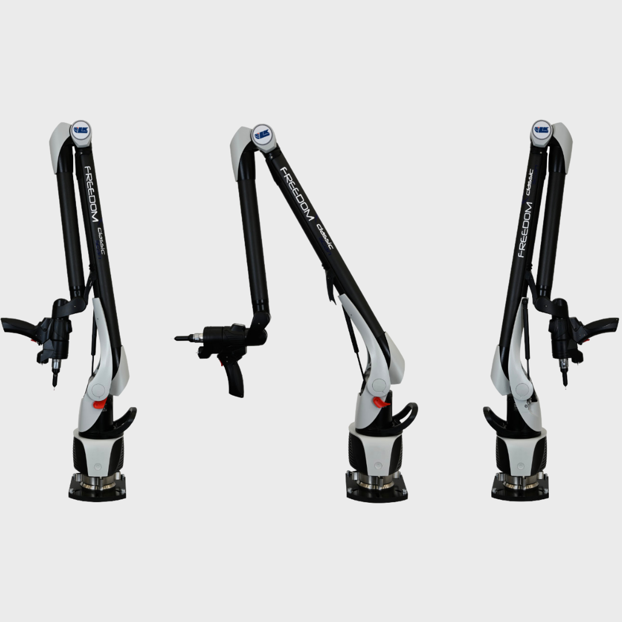
Week 1 Progress Review
L Matota – 24989142
Found a few research papers on the design and implementation of portable measurement arms (PMA)
Found determining factors when choosing what kind of PMA to choose
Size of parts to be measured
Level of accuracy
Throughput requirements
Found a few fields where the use of PMAs was justified/acceptable
Automotive
Medicine
Robotics
Telecommunications

Slide 2
Next Steps
Read through research papers and start literature review
Choose an appropriate field to go into (Most likely automotive, tap into F1)
Start listing requirements and specifications for joint design with respect to PMAs used in that F1 engineering

